Slide 1
CSE 211
Digital Design
Synchronous Sequential Logic

Slide 2
Storage Elements
LATCHES
SR Latch
D Latch
FLIP-FLOPS
D Flip-Flop
JK Flip-Flop
T Flip-Flop

Slide 3
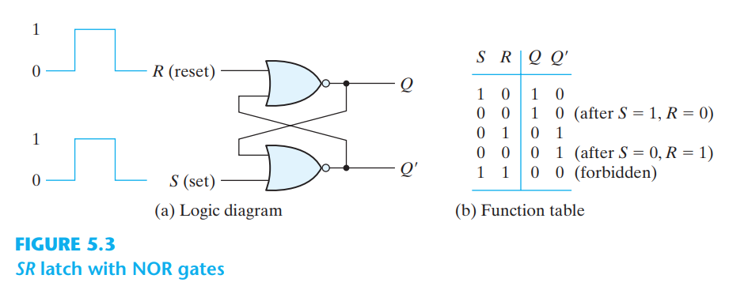
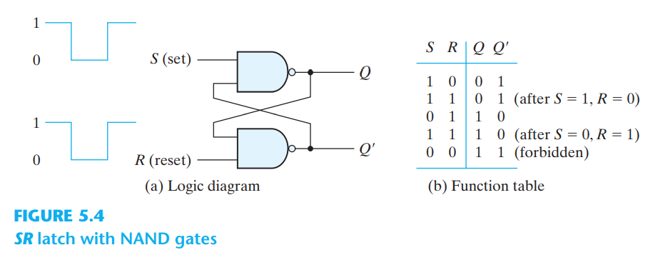
SR Latch

Slide 4
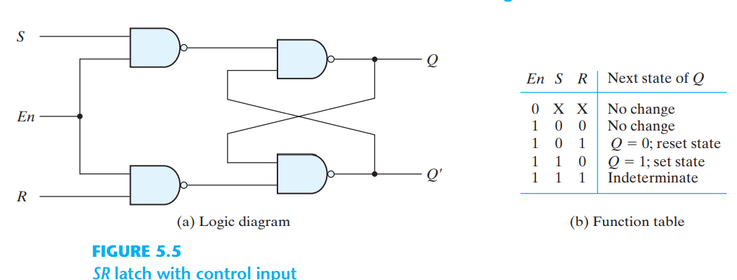
SR Latch with Control Input (Enable Input)
Let’s draw this diagram on Proteus

Slide 5
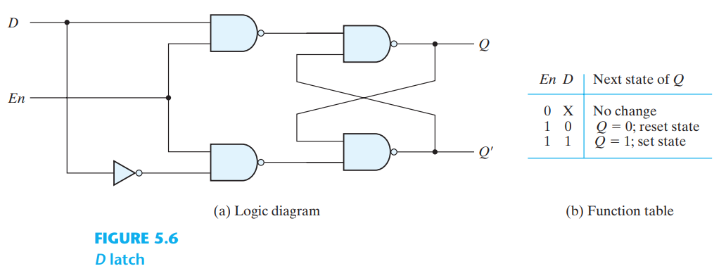
D Latch
Exercise 1: Now, let’s draw D Latch diagram on Proteus

Slide 6
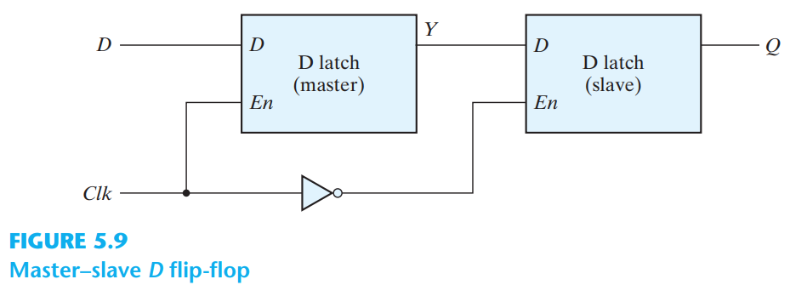
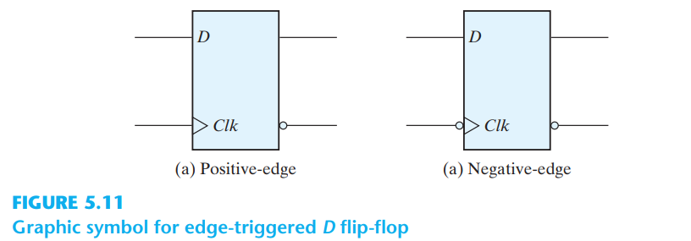
D Flip-Flop
Exercise 2:
Now, let’s draw D Flip-Flop

Slide 7
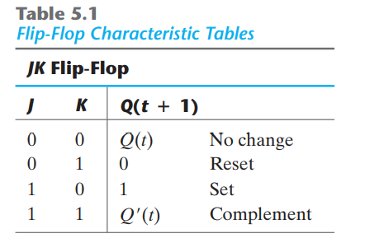
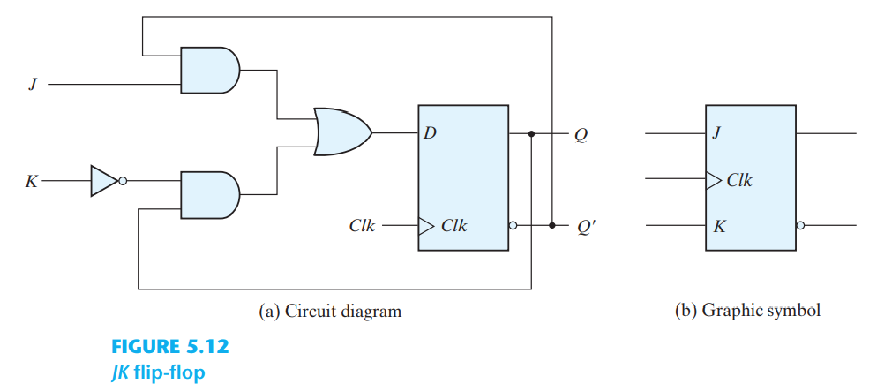
JK Flip-Flop
Exercise 3: Let’s draw JK Flip-Flop

Slide 8
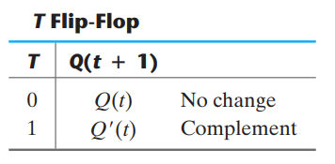
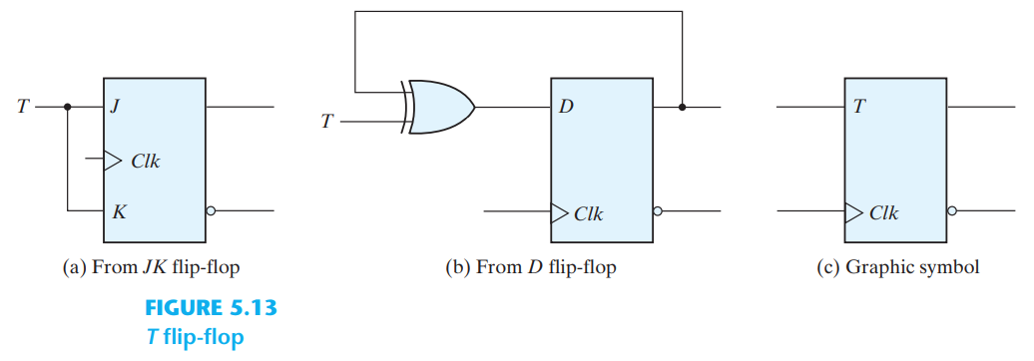
T Flip-Flop
Exercise 4: Let’s draw T Flip-Flop

Slide 9
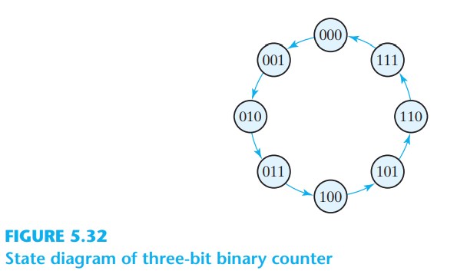
Exercise 5: Binary Counter using T Flip-Flop
An n -bit binary counter consists of n flip-flops that can count in binary from 0 to 2n - 1

Slide 10
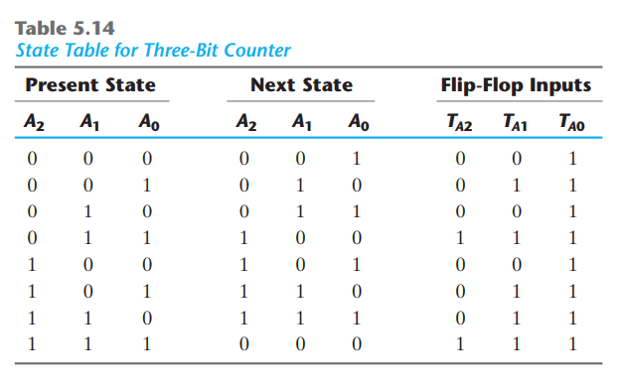
Binary Counter using T Flip-Flop

Slide 11
